Slide 1
English Speaking
Jiahui Shen and Michael Wang

Slide 2
Ordering food
https://www.youtube.com/watch?v=FDbBgcjDrtU
https://www.youtube.com/watch?v=hUU8hwl7WHA
You will pretend to be at a restaurant. It can either be a sit-down restaurant or a fast food restaurant.
One person will be the waiter/waitress. One or two other people will be ordering food.

Slide 3
Ordering food
Remember! At a fast-food restaurant, the cashier asks you want you want. You say what you want (food, drink) and then pay
At a sit-down restaurant, a waiter will ask what you want. He or she will first ask about what you want to drink. Then, he or she will take your orders. You can order an appetizer (first), soup or salad (salad), entree (second) and sides (with entree)

Slide 4
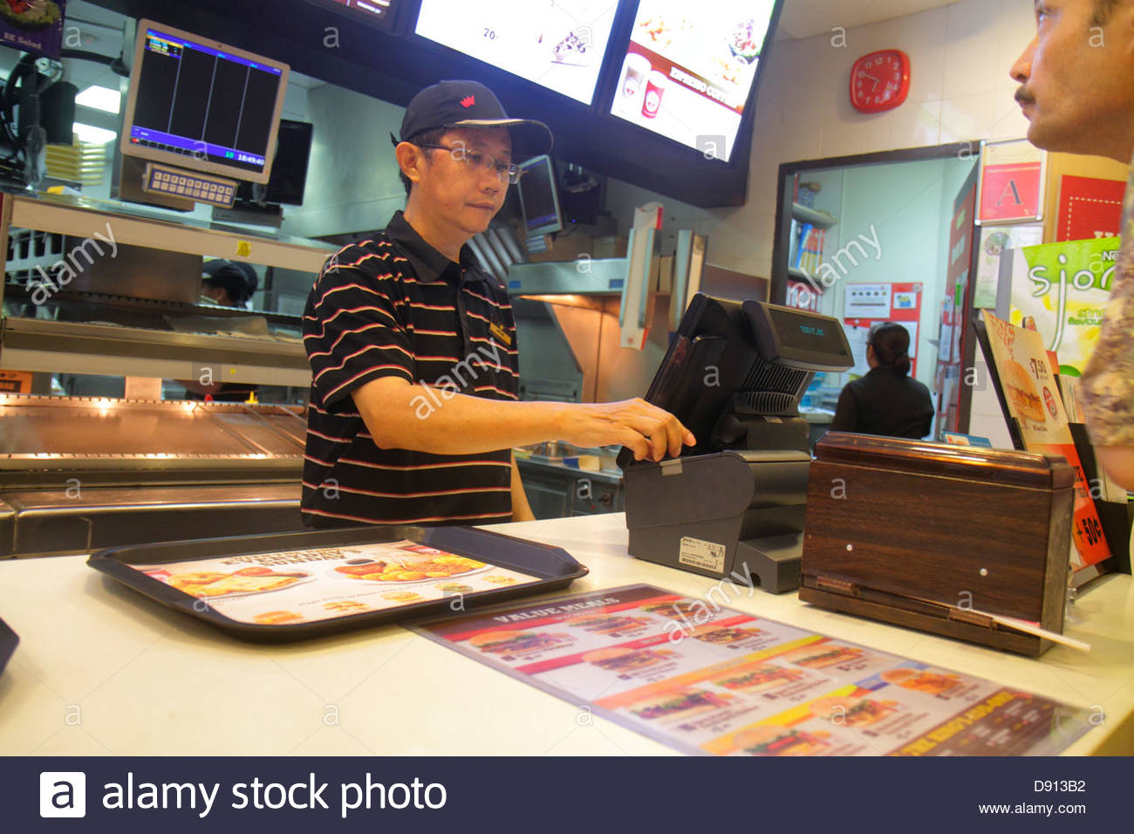
Fast food

Slide 5
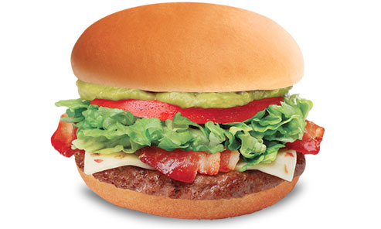
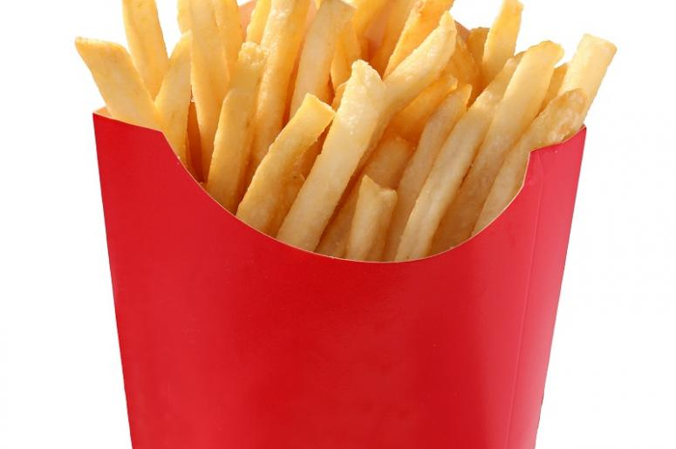
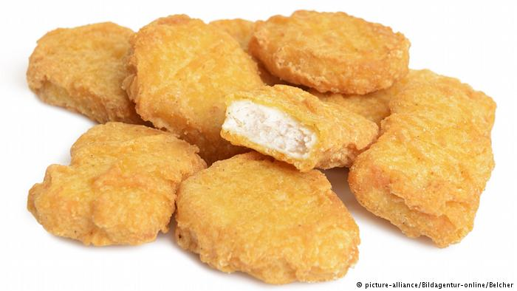
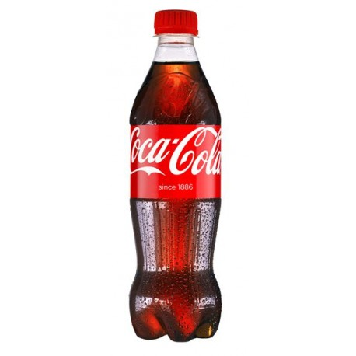
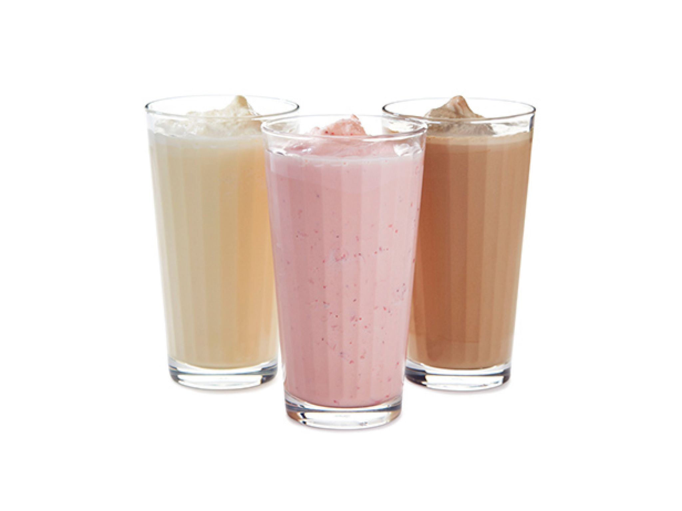
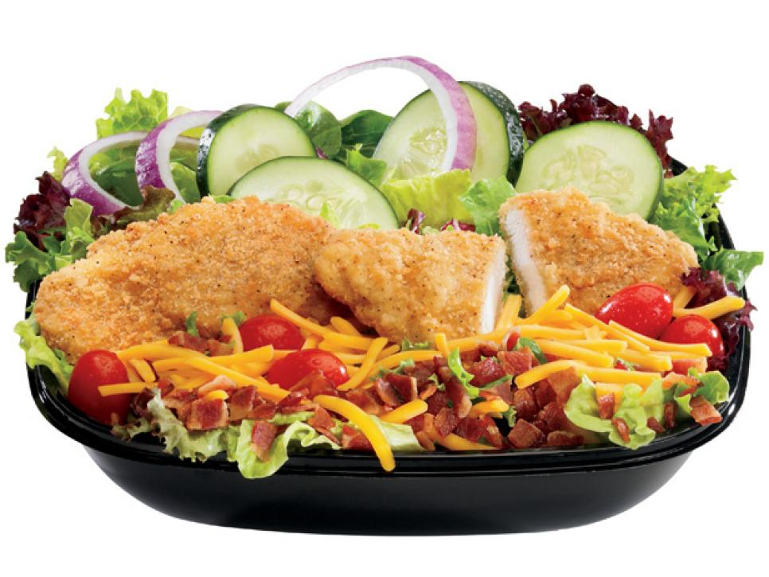
Fast food items
Hamburger or cheeseburger
Fries (small, medium, large)
Chicken Nuggets (5 piece, 10 piece)
Coke (small, medium, large)
Milkshake (strawberry, chocolate, vanilla)
Salad (large, small)

Slide 6
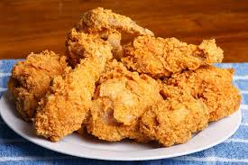
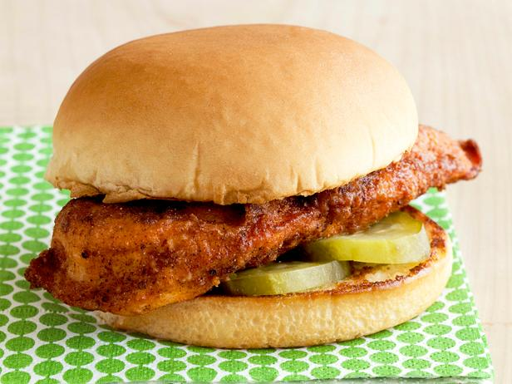
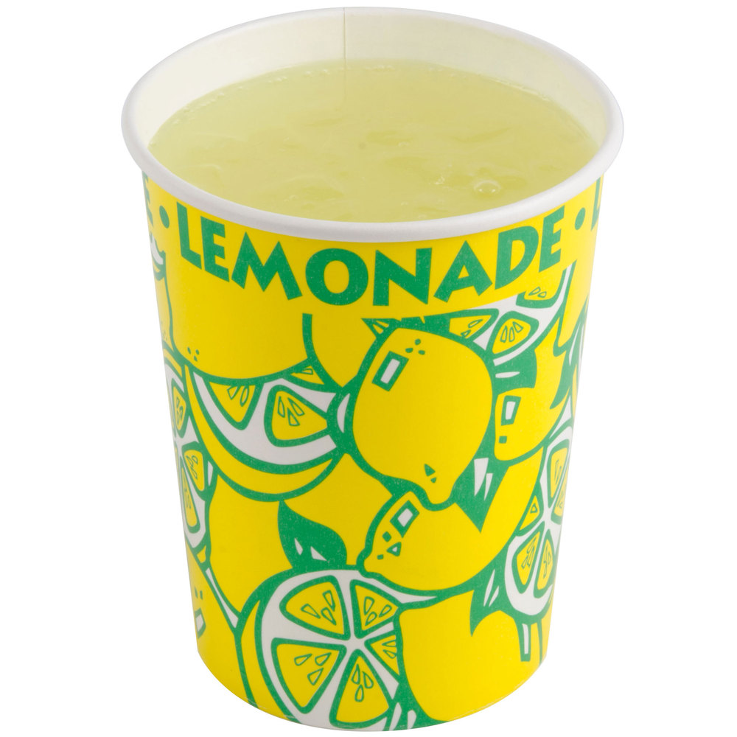
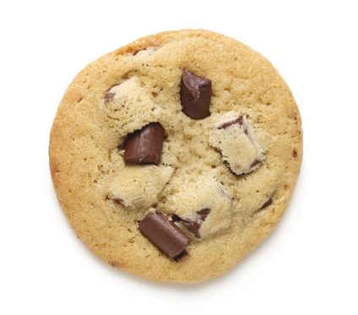
Fast food items
Fried chicken (2 piece, 4 piece)
Chicken sandwich
Lemonade (small, medium, large)
2 cookies

Slide 7
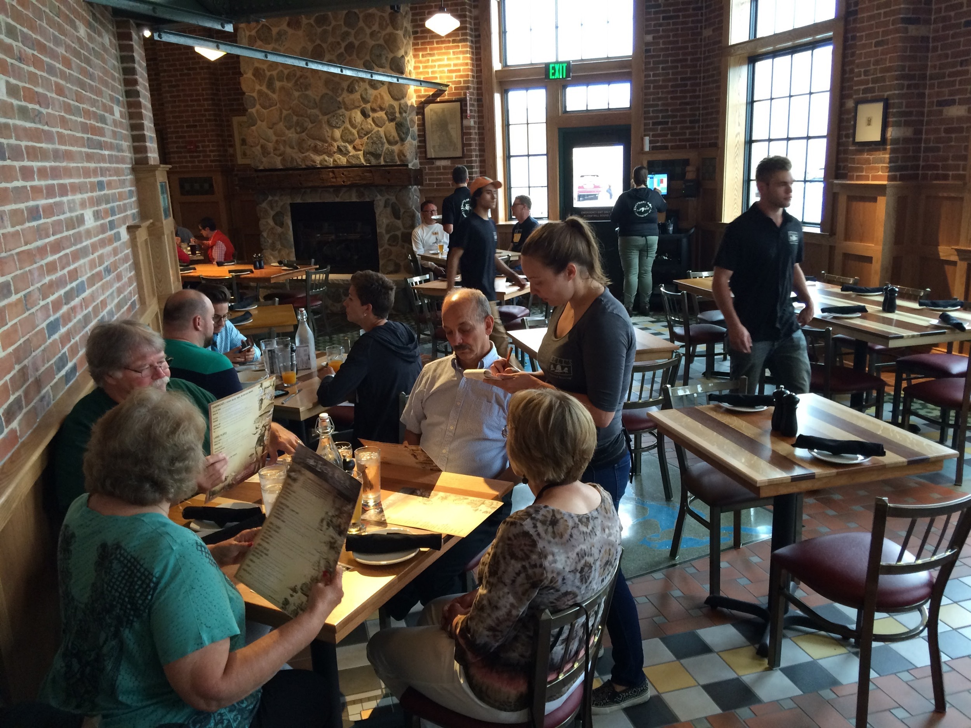
Sit-down restaurant

Slide 8
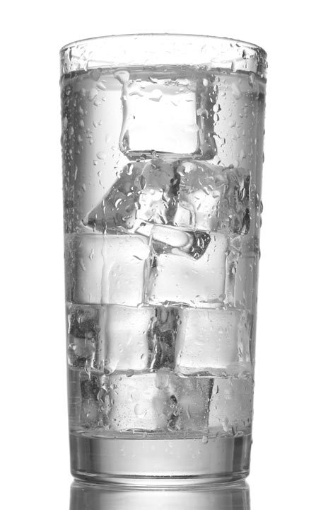
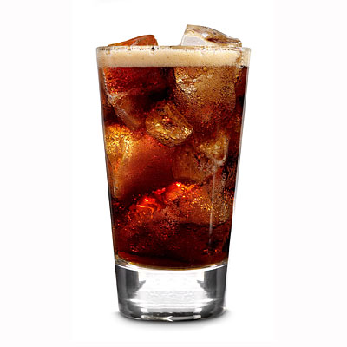
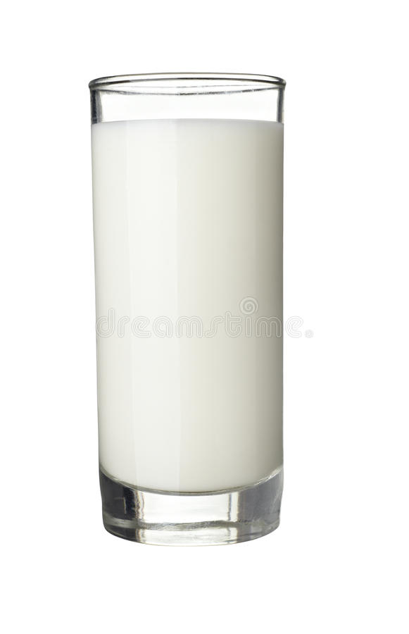
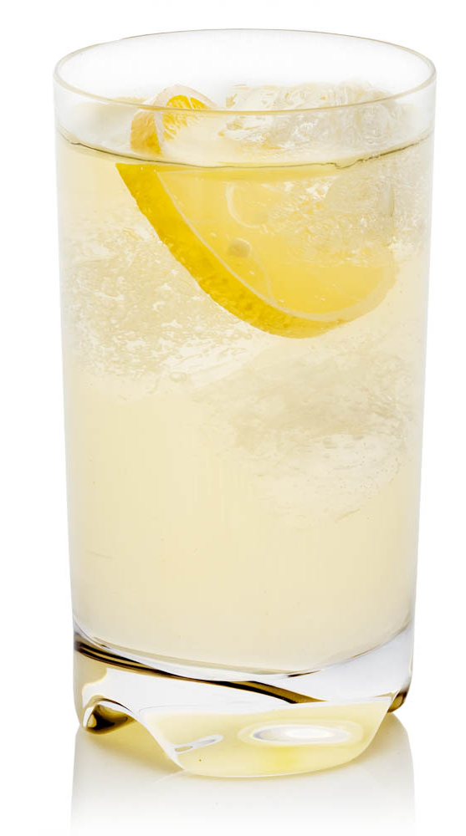
Sit-down restaurant drinks
Water with ice
Coke
Milk
Lemonade

Slide 9
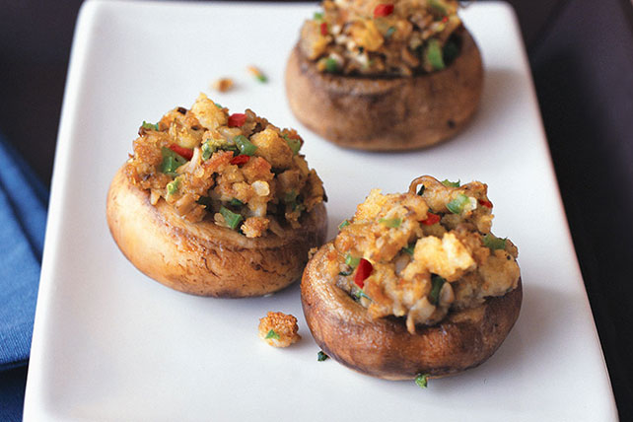
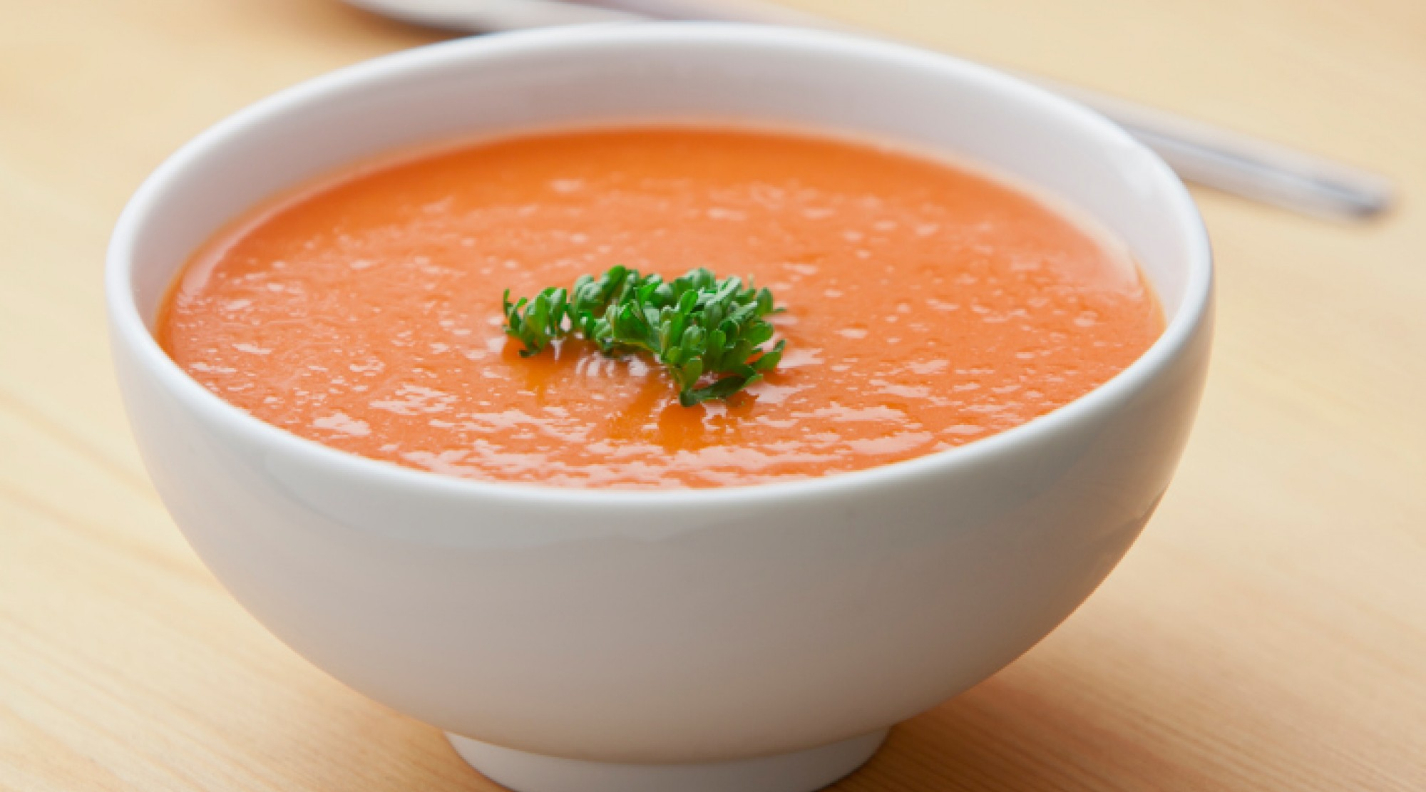
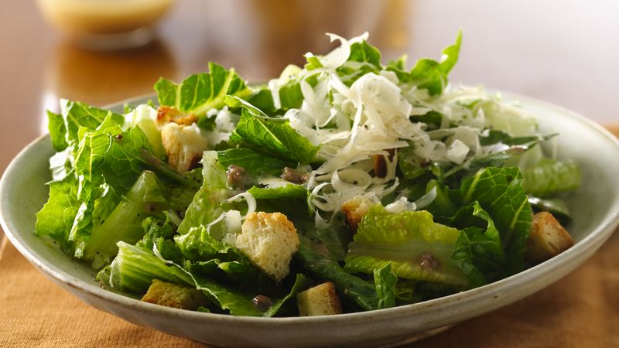
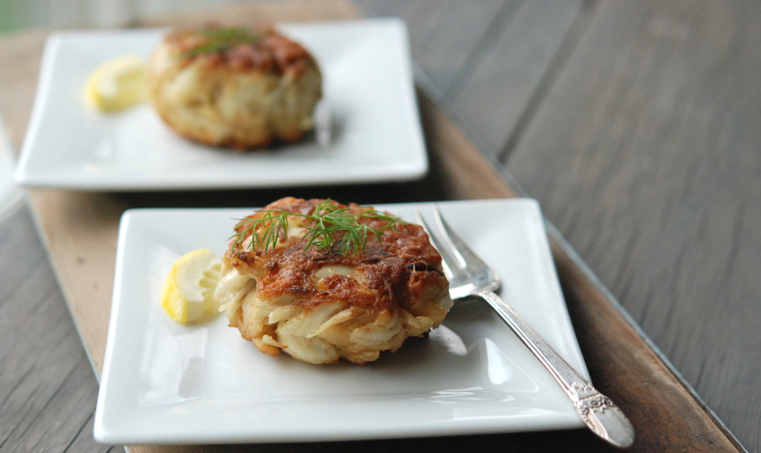
Sit-down restaurant soups, salads, appetizers/starters
Stuffed mushrooms
Tomato soup
Salad
Crab cakes

Slide 10
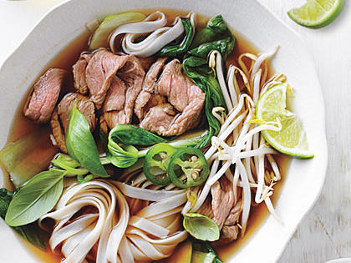
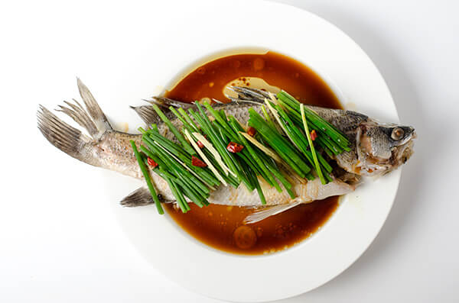
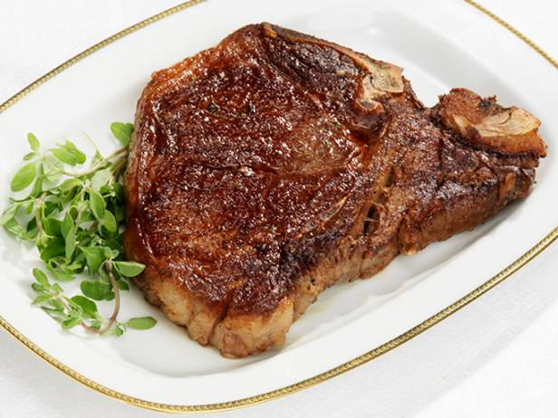
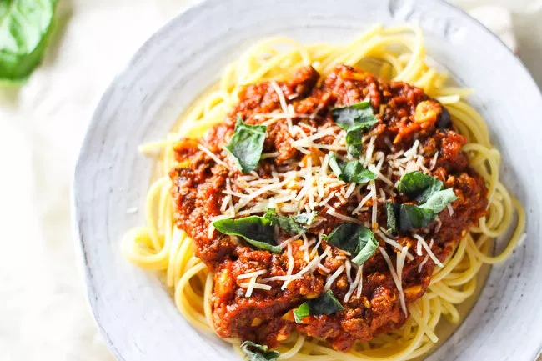
Sit-down restaurant menu entrees
Noodle soup (beef, chicken)
Steamed whole fish
WITH 2 SIDES
Steak (rare, medium, well-done)
WITH 2 SIDES
Spaghetti

Slide 11
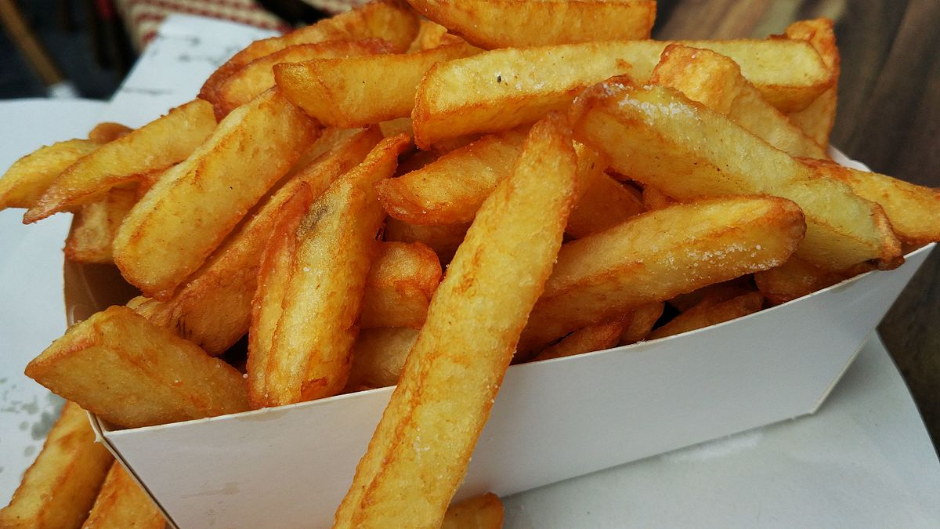
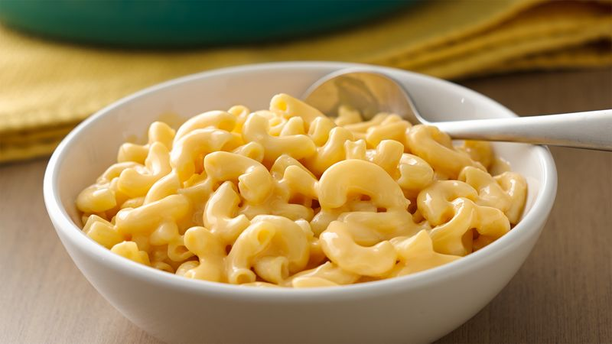
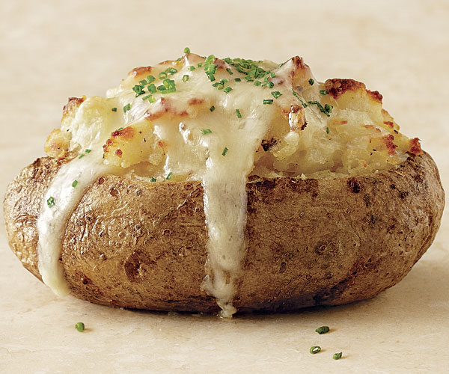
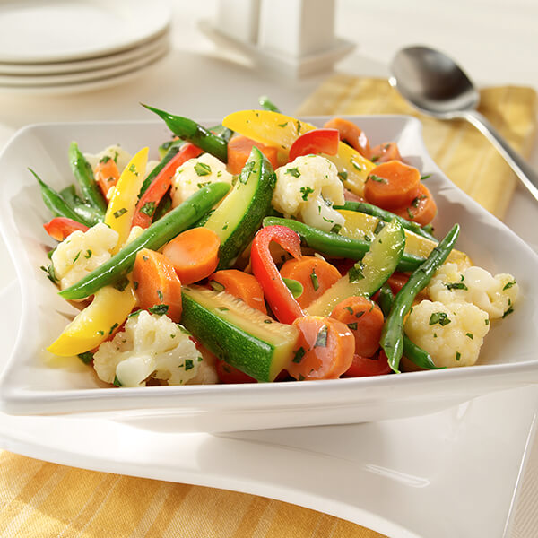
Sit-down restaurant sides
Fries
Macaroni and cheese
Baked potato
Steamed vegetables

